Slide 1



EB5104: Decision Making and Optimization
Demand Forecasting: Electricity and Gas in Singapore
Group 14:
Apurv Garg
Daksh Gupta
Dibyajyoti Panda
Gopesh Dwivedi
Indu Arya
Meghna Vinay Amin
Tran Duc
Submitted to:
Prof. Tang Loon Ching
Industrial and Systems Engineering
(Faculty of Engineering)
National University of Singapore

Slide 2
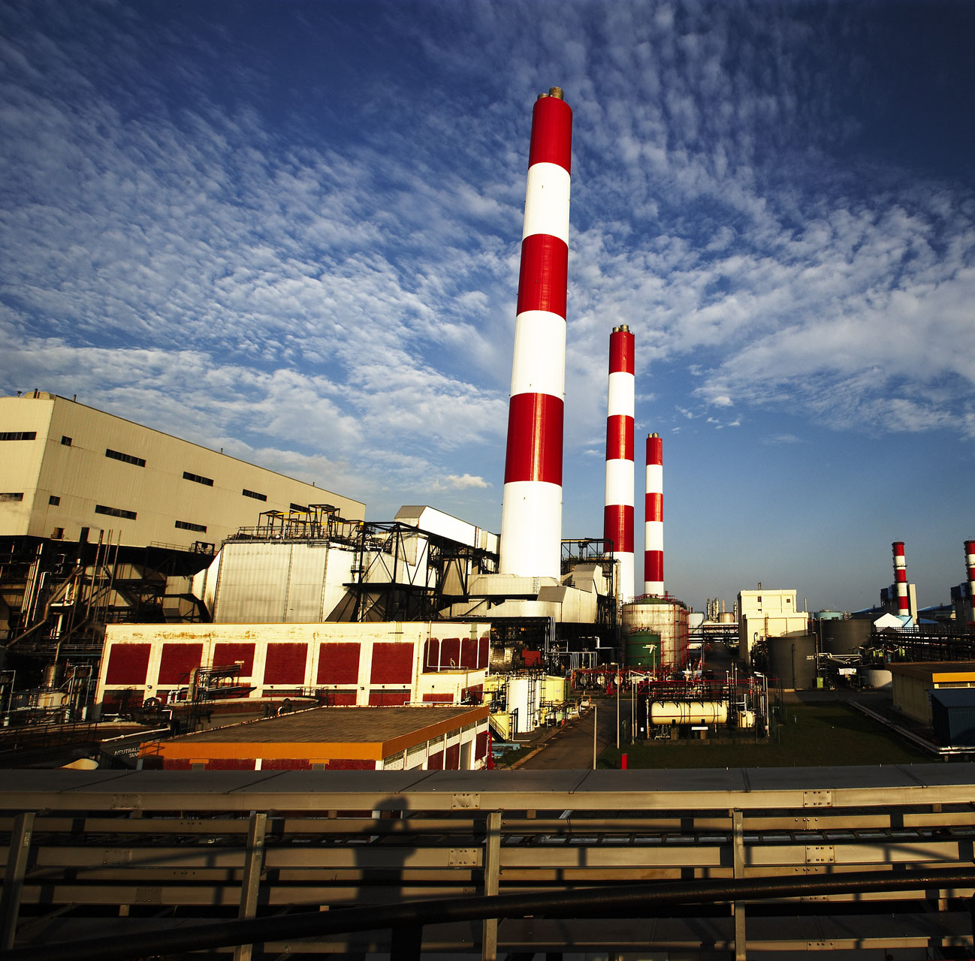
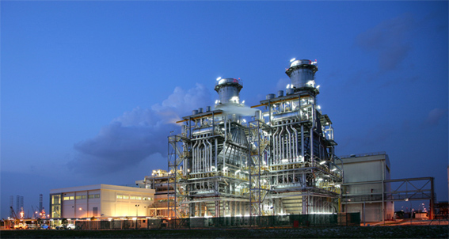

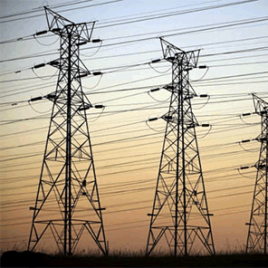
Contents
Outline
Introduction
Data
Forecasts
Performance
Conclusion
Annexure

Slide 3
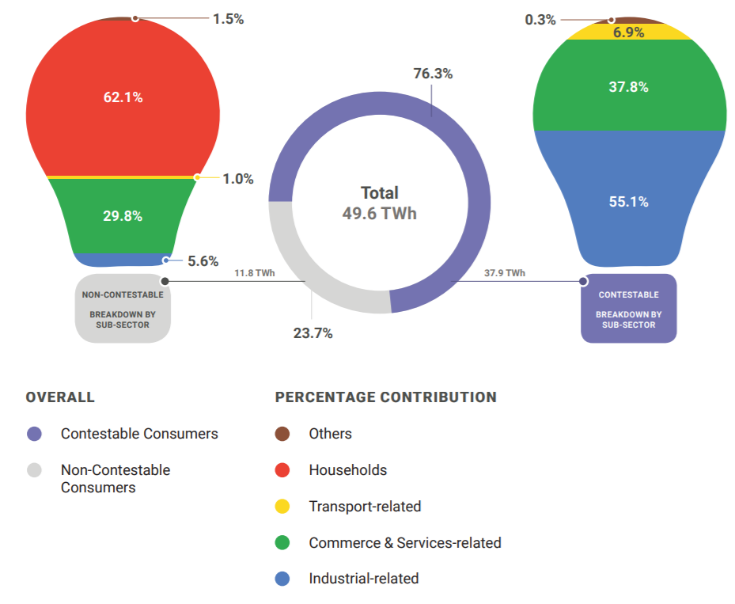
Demand of
Electricity and Natural Gas in Singapore
Introduction
The total electricity generation capacity in Singapore grew slightly from 13,611.9 MW in 2017 to 13,614.4 MW in 2018¹ due to an increase in the generation capacity of Solar Photovoltaic (PV).
The launch of the electricity futures market in 2015 facilitated the entry of more independent retailers, hence increasing retail competition and bringing benefits to consumers.
Singapore’s total electricity consumption rose by 2.1% from 48.6 TWh in 2016 to 49.6 TWh in 2017. Contestable Consumers (CCs) made up the bulk of consumption, accounting for 76.3% of the total consumption in 2017.
Data
Forecasts
Performance
Conclusion
Annexure
Source: The Singapore Energy Statistics (SES), the Energy Market Authority (EMA)'s annual publication

Slide 4
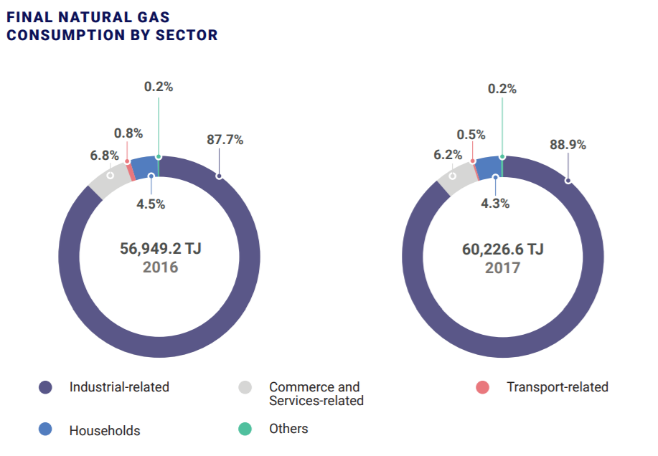
Demand of
Electricity and Natural Gas in Singapore (Cont.)
Introduction
End-users’ consumption of NG increased by 5.8%, from 56,949.2 TJ in 2016 to 60,226.6 TJ in 2017. Industrial-related consumption, which comprised the bulk (i.e. 88.9%) of NG’s end use, increased from 49,968.5 TJ in 2016 to 53,525.0 TJ in 2017, catalyzing the rise in overall NG consumption.
Households’ consumption of NG rose by 2.2% to 2,604.3 TJ in 2017. In contrast, the Commerce & Services-related sector declined by 3.9% to 3,706.9 TJ in 2017.
In 2017, the average monthly town gas consumption of a 4-room public housing unit was 75.6 kWh.
Data
Forecasts
Performance
Conclusion
Annexure
Source: The Singapore Energy Statistics (SES), the Energy Market Authority (EMA)'s annual publication

Slide 5

Overview
Demand Forecasting & Time Series
Demand forecasting is a field of predictive analytics which tries to understand and predict customer demand to optimize supply decisions by corporate supply chain and business management.
Introduction
Data
A time series is a series of data points indexed (or listed or graphed) in time order. Most commonly, a time series is a sequence taken at successive equally spaced points in time. Thus it is a sequence of discrete-time data.
Forecasts
Performance
Methods used in our study:
Smoothing (Exponential and Holt-Winters) : Smoothing is usually done to help us better see patterns, trends for example, in time series. Exponential smoothing is a rule of thumb technique for smoothing time series data using the exponential window function. Whereas in the simple moving average the past observations are weighted equally, exponential functions are used to assign exponentially decreasing weights over time
Decomposition: The decomposition of time series is a statistical task that deconstructs a time series into several components, each representing one of the underlying categories of patterns
Seasonal ARIMA: The seasonal part of an ARIMA model has the same structure as the non-seasonal part: it may have an AR factor, an MA factor, and/or an order of differencing. In the seasonal part of the model, all of these factors operate across multiples of lag s (the number of periods in a season)
Conclusion
Annexure

Slide 6
What is the
Need for Demand Forecasting?
Introduction
Energy demand forecasting is an essential component for energy planning, formulating strategies and recommending energy policies.
Short-term demand forecasting also plays a role in the process of regulation. A precise estimate of demand is important for the purpose of setting tariffs. A detailed consumer category-wise consumption forecast helps in the determination of a just and reasonable tariff structure wherein no consumer pays less than the cost incurred by the utility for supplying the power.
As a wide variety of methods is used in energy demand forecasting, there is need for an understanding of the approaches and their relevance in different contexts.
However, Projected demands are often found to deviate from the actual demands due to limitations in the model structure or inappropriate assumptions.
Data
Forecasts
Performance
Conclusion
Annexure

Slide 7
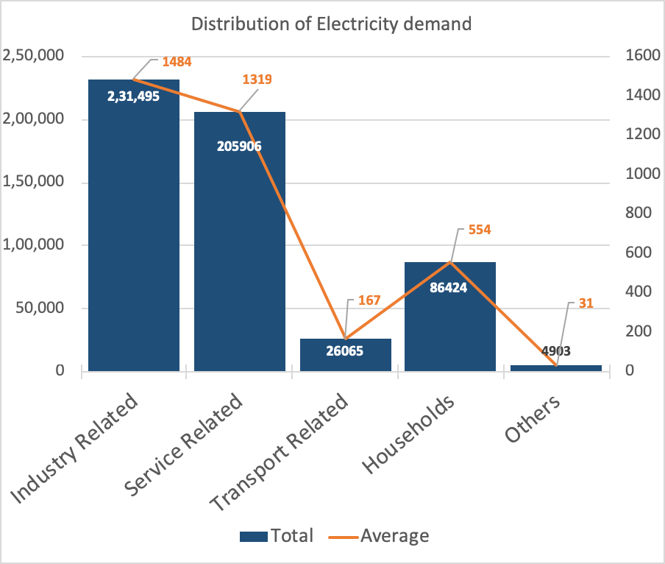
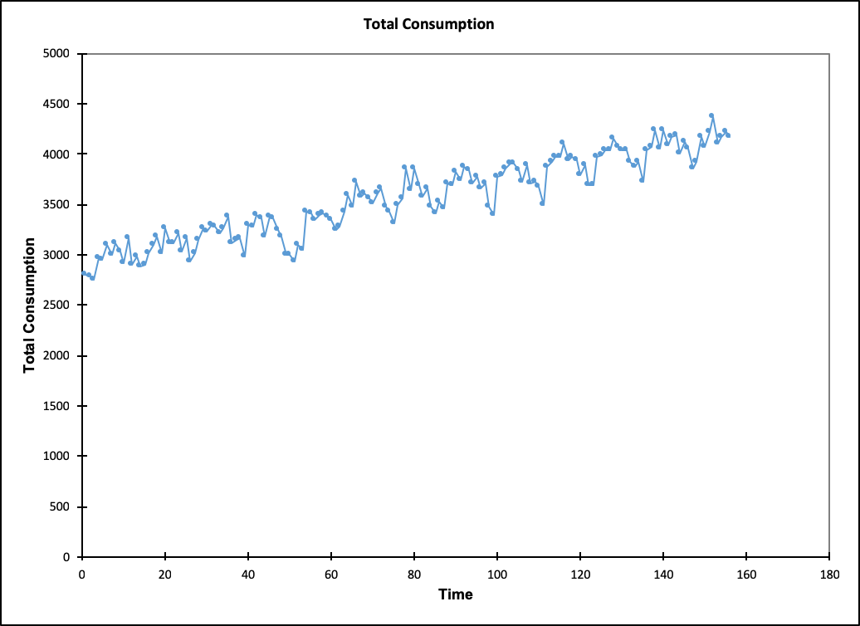
Electricity
Data: Source
Source: Data.gov.sg
Period: January 2005 to December 2017 (Monthly)
Monthly electricity consumption by sector for contestable and non-contestable consumers (in GWh)
Electricity Consumption Sectors:
Industry Related
Transport Related
Service Related
Households
Others
Introduction
Data
Forecasts
Performance
Conclusion
Annexure
Data: Understanding
Trend: Increasing
Seasonality: Present
Cyclicity: Present
Irregularity: Present

Slide 8
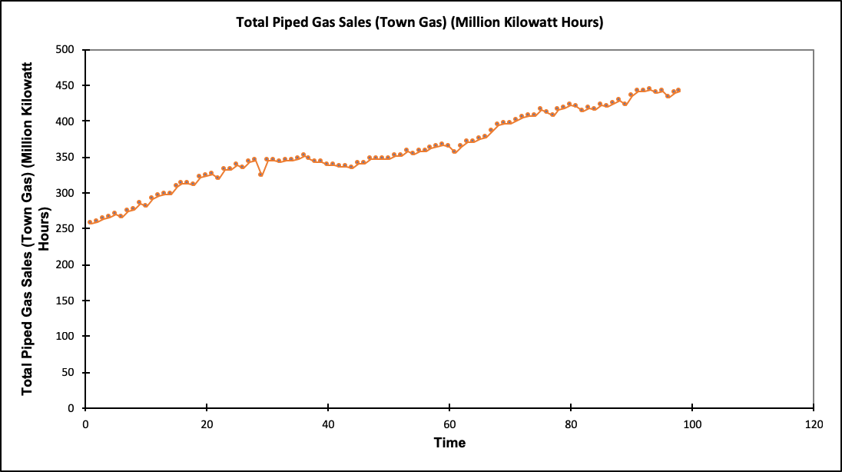
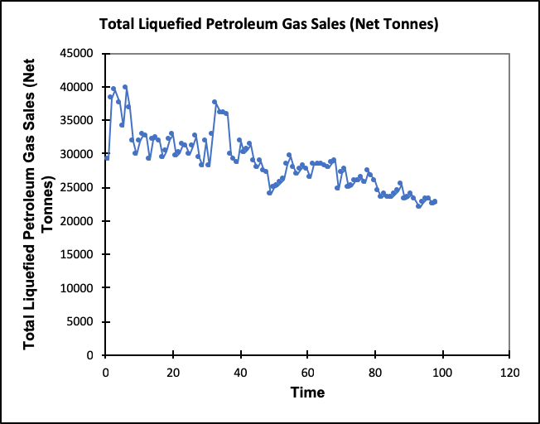
Natural Gas
Data: Source
Source: Singstat.gov.sg
Period: 1994 to 2018
Quarterly gas consumption
Data:
Total Piped Gas Consumption
Total LPG Consumption
Introduction
Data
Forecasts
Performance
Conclusion
Annexure
Data: Understanding
Piped Gas:
Trend: Increasing
Seasonality: Absent
Cyclicity: Absent
Irregularity: Present
LPG:
Trend: Decreasing
Seasonality: Absent
Cyclicity: Absent
Irregularity: Present

Slide 9
Electricity
Forecasting: Techniques
Introduction
Data
Forecasts
Performance
Conclusion
Annexure
We found that Holt-Winters smoothing gave best performance for forecasting Total Consumption of Electricity. Model parameters used for the same are provided on the right. Next slides contains individual best performing models for the different components.
Model parameters (Total Consumption):
Statistic | Parameter | Standard error
alpha | 0.244211606 | 0.00042623
Beta | 0.020477065 | 0.000113902
Gamma | 0.233 | 0.001
S1 | 2957.433
T1 | 0.000

Slide 10
Electricity
Forecasting: Techniques
Introduction
Data
Forecasts
Performance
Conclusion
Model parameters:
Parameter | Value | Hessian standard error | Lower bound (95%) | Upper bound (95%)
Constant | -0.013 | 0.161 | -0.327 | 0.302
Parameter | Value | Hessian standard error | Lower bound (95%) | Upper bound (95%) | Asympt. standard error | Lower bound (95%) | Upper bound (95%)
AR(1) | 0.315 | 0.077 | 0.165 | 0.465 | 0.118 | 0.084 | 0.546
AR(2) | 0.296 | 0.081 | 0.137 | 0.454 | 0.091 | 0.117 | 0.475
AR(3) | 0.107 | 0.078 | -0.045 | 0.259 | 0.093 | -0.075 | 0.289
SAR(1) | 0.096 | 0.123 | -0.146 | 0.338 | 0.093 | -0.086 | 0.278
SAR(2) | 0.039 | 0.108 | -0.172 | 0.251 | 0.115 | -0.187 | 0.266
SAR(3) | -0.010 | 0.103 | -0.212 | 0.191 | 0.107 | -0.219 | 0.198
MA(1) | -1.000 | 0.030 | -1.059 | -0.941 | 0.070 | -1.137 | -0.863
SMA(1) | -0.824 | 0.132 | -1.083 | -0.565 | 0.097 | -1.015 | -0.633
Annexure
Intercept | 1101.057386
Slope | 2.787967315
Month | Seasonality Index
January | 0.96
February | 0.95
March | 0.95
April | 0.99
May | 1.00
June | 1.02
Month | Seasonality Index
July | 1.00
August | 1.03
September | 1.00
October | 1.01
November | 1.02
December | 0.99

Slide 11
Forecasting: Techniques (Cont.)
Introduction
Data
Forecasts
Performance
Conclusion
Model parameters:
Parameter | Value | Hessian standard error | Lower bound (95%) | Upper bound (95%)
Constant | 0.032 | 0.142 | -0.247 | 0.311
Parameter | Value | Hessian standard error | Lower bound (95%) | Upper bound (95%) | Asympt. standard error | Lower bound (95%) | Upper bound (95%)
AR(1) | 0.567 | 2.677 | -4.680 | 5.814 | 0.054 | 0.461 | 0.672
AR(2) | -0.152 | 0.536 | -1.202 | 0.898 | 0.077 | -0.303 | -0.001
SAR(1) | -0.528 |  |  |  | 0.100 | -0.725 | -0.331
SAR(2) | 0.274 |  |  |  | 0.098 | 0.083 | 0.466
MA(1) | -0.795 | 2.631 | -5.952 | 4.362 | 0.062 | -0.917 | -0.673
MA(2) | 0.280 | 0.999 | -1.677 | 2.237 | 0.067 | 0.148 | 0.411
SMA(1) | -0.088 |  |  |  | 0.067 | -0.219 | 0.042
SMA(2) | -0.820 |  |  |  | 0.065 | -0.948 | -0.692
Model parameters:
Parameter | Value | Hessian standard error | Lower bound (95%) | Upper bound (95%)
Constant | 0.078 | 0.003 | 0.073 | 0.083
Parameter | Value | Hessian standard error | Lower bound (95%) | Upper bound (95%) | Asympt. standard error | Lower bound (95%) | Upper bound (95%)
AR(1) | 0.057 | 0.077 | -0.093 | 0.207 | 0.086 | -0.113 | 0.226
AR(2) | -0.522 | 0.079 | -0.677 | -0.367 | 0.087 | -0.692 | -0.352
SAR(1) | -0.791 | 0.097 | -0.980 | -0.602 | 0.095 | -0.977 | -0.605
SAR(2) | -0.277 | 0.096 | -0.466 | -0.089 | 0.095 | -0.463 | -0.091
Annexure

Slide 12
Forecasting: Techniques (Cont.)
Introduction
Data
Forecasts
Performance
Conclusion
Annexure
Model parameters:
Parameter | Value | Hessian standard error | Lower bound (95%) | Upper bound (95%)
Constant | 0.052 | 0.084 | -0.112 | 0.217
Parameter | Value | Hessian standard error | Lower bound (95%) | Upper bound (95%) | Asympt. standard error | Lower bound (95%) | Upper bound (95%)
AR(1) | -0.517 | 0.074 | -0.663 | -0.371 | 0.086 | -0.686 | -0.348
SAR(1) | -0.283 | 0.083 | -0.445 | -0.121 | 0.094 | -0.468 | -0.098

Slide 13
Natural Gas
Forecasting
Introduction
Data
Forecasts
Performance
Conclusion
Annexure
Model parameters:
Parameter | Value | Hessian standard error | Lower bound (95%) | Upper bound (95%)
Constant | 8.256 | 45.341 | -80.611 | 97.123
Parameter | Value | Hessian standard error | Lower bound (95%) | Upper bound (95%) | Asympt. standard error | Lower bound (95%) | Upper bound (95%)
AR(1) | -0.200 | 0.097 | -0.390 | -0.011 | 0.101 | -0.399 | -0.002
AR(2) | -0.508 | 0.108 | -0.720 | -0.296 | 0.103 | -0.710 | -0.307
SAR(1) | -1.048 | 0.107 | -1.258 | -0.838 | 0.106 | -1.256 | -0.839
SAR(2) | -0.436 | 0.102 | -0.636 | -0.236 | 0.106 | -0.645 | -0.228
Model parameters
Statistic | Parameter | Standard error
alpha | 0.83839 | 0.010086
S1 | 257.4

Slide 14
Electricity
Error Statistics & Evaluation
Introduction
Time Series | Error Statistics | Smoothing | Decomposition | ARIMA
Industry Related | RMSE | 59.46 | 51.51 | 45.8
 | MAPE | - | - | 2.33
Service Related | RMSE | 55.61 | 38.55 | 36.67
 | MAPE | - | - | 1.86
Transport Related | RMSE | 7.89 | 8.63 | 5.97
 | MAPE | 3.51 | - | 2.25
Households | RMSE | 31.04 | 42.47 | 17.5
 | MAPE | - | - | 2.09
Others | RMSE | 1.92 | 3.86 | 1.83
 | MAPE | - | - | 3.64
Total Consumption (Forecasted Directly) | RMSE | 92.1 | 134.31 | 96.18
 | MAPE | 2.056 | - | 1.93
Data
Forecasts
Performance
Conclusion
Annexure
Table 1: Error Statistics for different techniques

Slide 15
Natural Gas
Error Statistics & Evaluation
Introduction
Time Series | Error Statistics | Smoothing | Decomposition | ARIMA
Piped Gas | RMSE | 5.77 | 11.1 | 6.25
 | MAPE | 1.28 | - | 1.34
LPG | RMSE | 2458.7 | 2088.2 | 1778.6
 | MAPE | 5.83 | - | 4.06
Data
Forecasts
Performance
Table 2: Error Statistics for Natural Gas Forecast
Conclusion
Annexure

Slide 16
Electricity & Natural Gas
Conclusion and Inferences
Introduction
For forecasting electricity demand, we followed two methods as follows:
1) Direct Method: Predicting the total consumption
2) Category Method: Predicting the individual components like Industry, Service, Transport, Household etc of total consumption, then summing up to get the total consumption.
Reason:
Individual components were observed to have unique trends, hence modelling for individual components would result in better capturing of trends.
Result:
Finally, Method 2 selected as it gave better prediction: RMSE - 74.32
For forecasting Natural Gas Demand, we used Exponential smoothing for Piped gas which gave RMSE of 5.7 and ARIMA for the LPG forecasting giving RMSE of 1,778.5.
Data
Forecasts
Performance
Conclusion
Annexure

Slide 17
Appendix
Excel Files & References
Introduction
Name | Description | Path
Electricity_Forecast_G14.xlsm | Workbook for Forecasting Electricity demand including both direct and indirect methods. Only best performing models are included for simplicity.
Gas_Forecast_G14.xlsx | Workbook for Forecasting Gas demand including Piped and LPG
Working Files (Folder) | Individual model files in xlsm format. Note: XLSTAT might be needed on the system. | Included in Zip
Data
Forecasts
Performance
Conclusion
Annexure
References
http://www.statsoft.com/Textbook/Demand-Forecasting
https://people.duke.edu/~rnau/411arim.htm
https://onlinecourses.science.psu.edu/stat510/node/49/
https://machinelearningmastery.com/decompose-time-series-data-trend-seasonality/

Slide 18
Thank you.
Group 14: Members Information
Apurv Garg e0267516@u.nus.edu A0178205E
Daksh Gupta daksh.gupta@u.nus.edu A0178466M
Dibyajyoti Panda dpanda@u.nus.edu A0178271Y
Gopesh Dwivedi g.d@u.nus.edu A0178338R
Indu Arya arya.indu@u.nus.edu A0178360B
Meghna Vinay Amin meghna.vinay@u.nus.edu A0178307Y
Tran Duc e0267497@u.nus.edu A0178186N
Copyright © 2018 National University of Singapore
All rights reserved. No part of this publication may be reproduced, distributed, or transmitted in any form or by any means, including photocopying, recording, or other electronic or mechanical methods, without the prior written permission of the authors, except in the case of brief quotations embodied in critical reviews and certain other noncommercial uses permitted by copyright law.

